Slide 1

Capstone Final Project: Plume Analysis
Justin Tice & Megan Hoeksema
March 1, 2023

Slide 2
Time Breakout
Preparation [45%]
Analysis [35%]
Interpretation and Conclusions [20%]

Slide 3
Monitoring in the Lekagul Wildlife Preserve Area
Mistford Pact of 2010 - ensure an environmentally sound and economically supportive partnership
9 air-sampling sensors are located around the town and in the preserve to monitor air quality.
Chemicals
AGOC-3 - Low-VOC: volatile organic compounds that are not harmful to the environment and humans.
Appluimonia - Odor producing substance, not at high enough levels that can cause serious harm, long-term heath effects or even death in humans and animals.
Chlorodinine - Corrosive disinfectant/sterilizing agent that is harmful if inhaled or swallowed.
Methylsomolene – A volatile organic compound that causes toxic side effects in vertebrates
Companies near the town
Roadrunner Fitness Electronics
Produces person fitness trackers, heart rate monitors, etc…
Kasios Office Furniture
Produces metal and composite-wood furniture
Radiance ColourTek
Produces solvent based optically variable metallic flake paints.
Indigo Sol Boards
Produces skateboards and snowboards

Slide 4
Research Questions
Characterize the sensors’ performance and operation. Are they all working properly at all times? Can you detect any unexpected behaviors of the sensors through analyzing the readings they capture?
Now turn your attention to the chemicals themselves. Which chemicals are being detected by the sensor group? What patterns of chemical releases do you see, as being reported in the data?
Which factories are responsible for which chemical releases? Carefully describe how you determined this using all the data you have available. For the factories you identified, describe any observed patterns of operation revealed in the data.

Slide 5
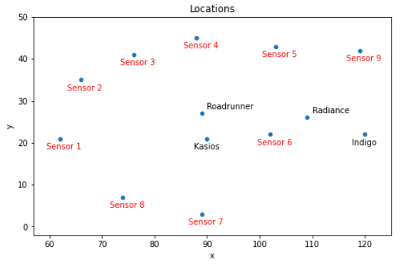
Datasets
Sensor data
3 months (April, August, December), every hour/day/month
9 different sensors
Readings of each chemical in parts per million (ppm)
Meteorological data
Time stamp, wind direction, wind speed
Location data
Gives the x, y coordinates for 9 sensors and 4 factories
Calculated the distances between each factory and sensor

Slide 6
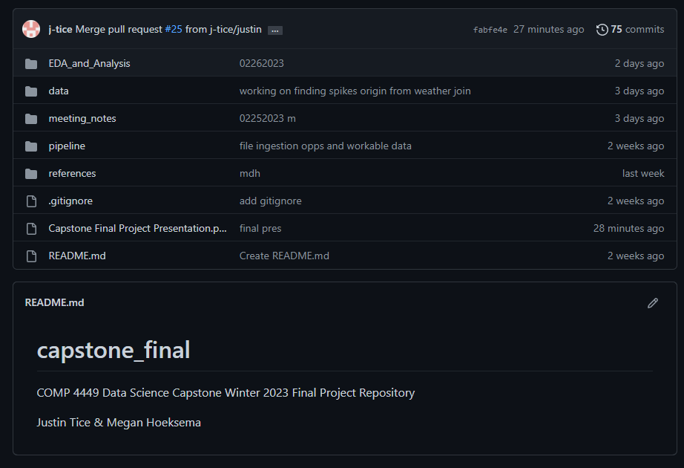
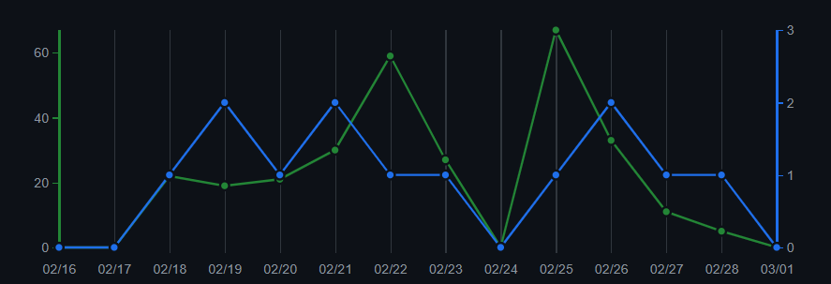
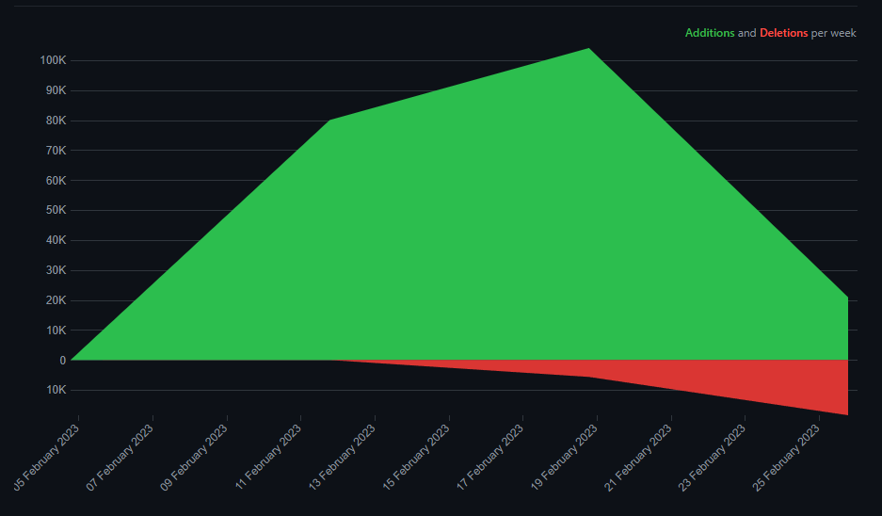
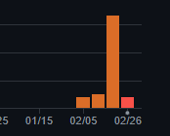
Project Organization
https://github.com/j-tice/capstone_final

Slide 7
ABCD Overview
A – Assessing
Assessment began with gaining familiarity with dataset description, contents, and relationships. Background information was gathered and consolidated on both sensors, business in the area, and the wildlife preserve in a general sense.
Initial research questions were formed based on cursory glances at both the data and the associated descriptions.
B – Best Action Plan
Plans for work distribution and project management were made prior to beginning any heavy lifting.
Timelines were created in order to leave room for modifications and improvements while still meeting deadlines.
Various methods were proposed to both analyze the data and work towards answering research questions
C – Choose Approach
Our final decision involved a two-step approach to tackling our research questions: one at the sensor level and one at the chemical level. This lets us answer questions about each, while allowing for a more nuanced conclusion to our questions.
D – Develop
Data cleaning, reformatting, and merging were carried out, as well as the creation of intermediary tables to carry out analysis. Numerical and logical analysis was carried out and then later backed through visualizations.

Slide 8
Data Preparation
Sensor Data
Rename column titles. The Date Time column has a whitespace at the end.
Convert the date time column to datetime in order to create visualizations.
No null values.
Meteorological Data
Minor cleaning to null values, formatting
Location Data
Data was provided in word file.
Pandas DF manually created.
Intermediary Datasets encompassing significant chemical readings and value counts were created, as well as a script to format data into workable file formats

Slide 9
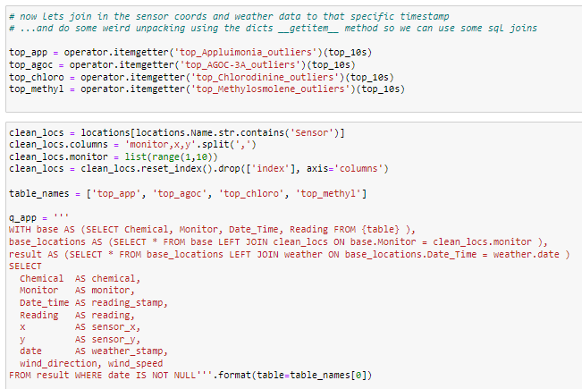
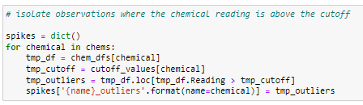
Data Preparation
The sensor, location, and weather data was also joined together on trimmed datasets
Since we needed to separate and analyze each chemical by itself, most of the data was created iteratively and inserted into dictionary values

Slide 10
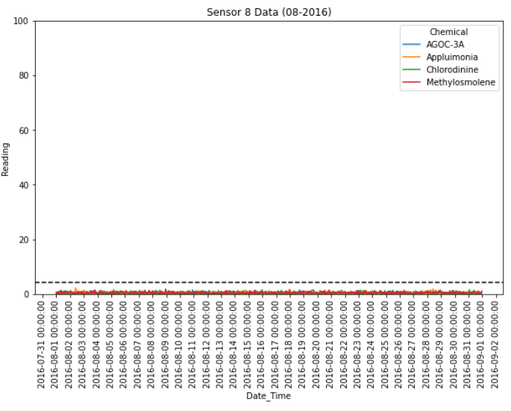
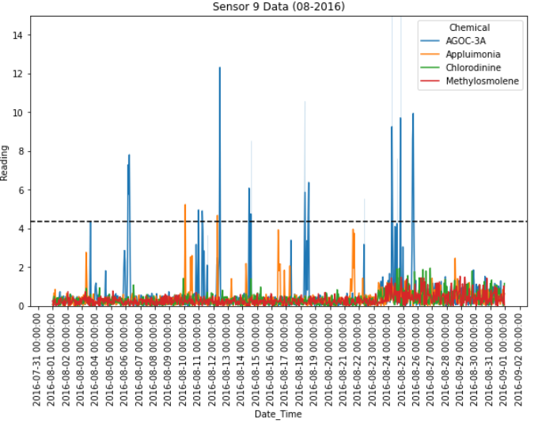
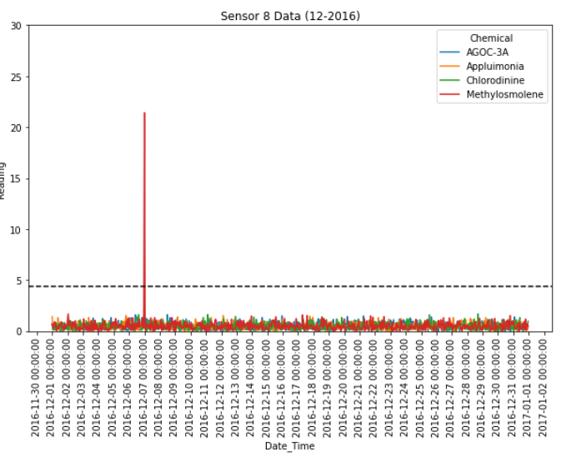
Characterization of the sensors’ performance and operation
Potentially Faulty Sensors/Unexpected Patters in Sensor Behavior
Sensor 8
In April, sensor is picking up 12 significant signals in ¾ chemicals. Going into August, it is only detecting background noise. Then going into December, only 1 spike in Methylosmolene is detected.
Sensor 9
In August, the background noise increases towards the end of the month.

Slide 11
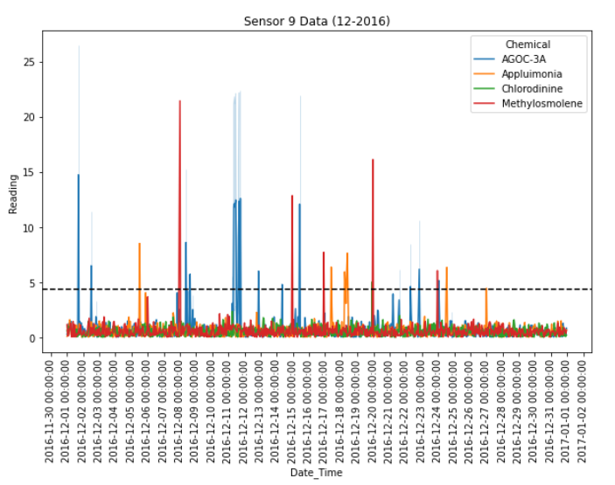
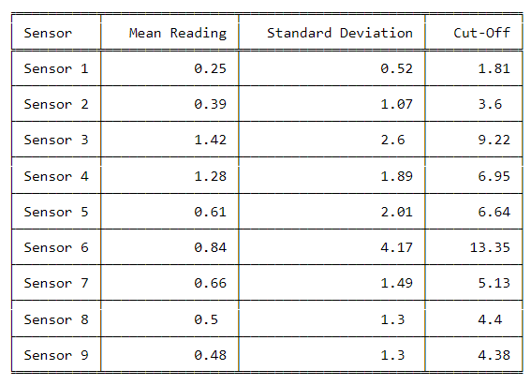
Characterization of the sensor’ performance and operation
In order to determine if a significant increase is being detected by each sensor, the mean of all readings in the sensor group was calculated, then the cutoff for significance was assigned as the mean + ( 3 * standard deviation).
Significance Cut-Off Calculations

Slide 12
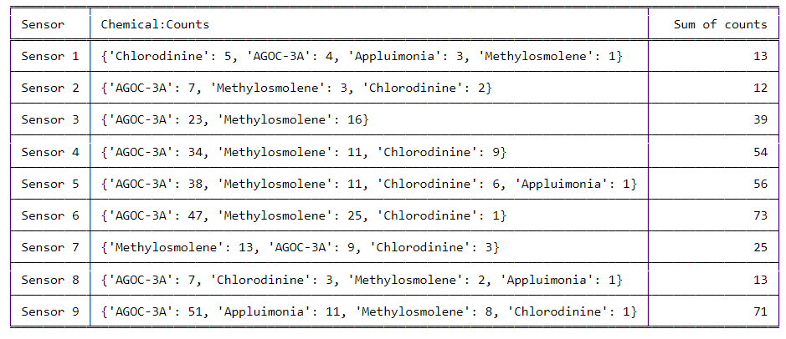
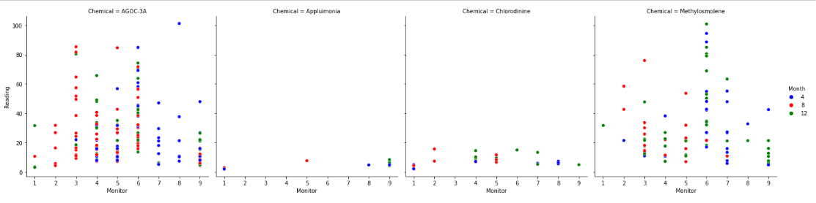
Which chemicals are being detected by the sensor group?
After determining the significance cut-offs, we then extracted the chemicals being detected above the cut-off for each sensor. Also extracted the number of times each chemical was being detected significantly.
Appluimonia is the least detected and detected at very low levels
Chlorodinine is detect on almost every sensor, however, at very low levels.
AGOC-3A is the most detected
AGOC-3A and Methylosmolene are detected on every sensor
Sensors 6 and 9 have the highest number of times chemicals are detected

Slide 13
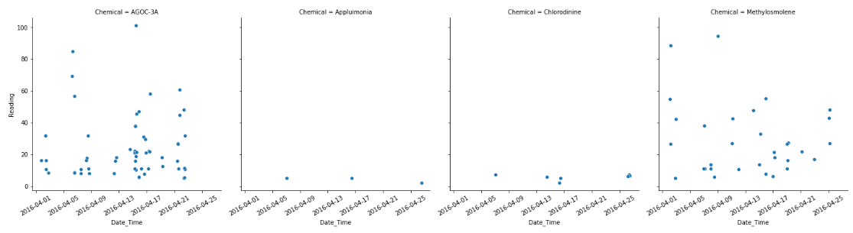
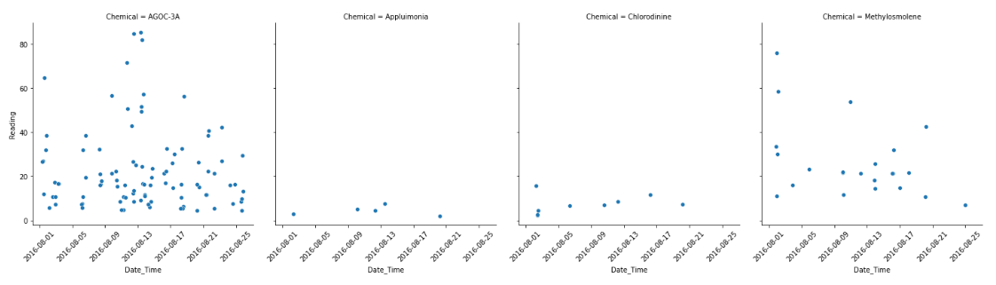
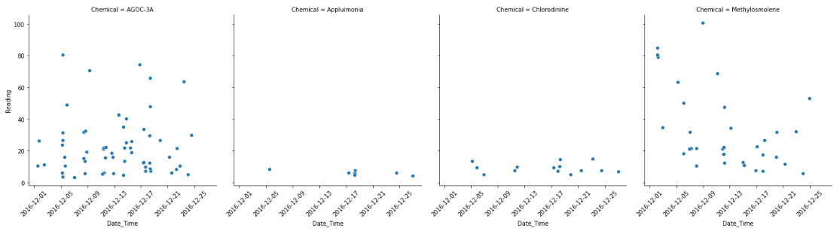
What patterns of chemical releases do you see, as being reported in the data?
April
We can see three distinct peaks in Appluimonia output over time.
ACOG-3A generally varies across time with no distinguishable pattern.
Chloridinine seems the most stable in magnitude over time.
Methylosmolene has a slight decrease over time, yet a high variance and noise in the data makes this unclear.
August
December

Slide 14
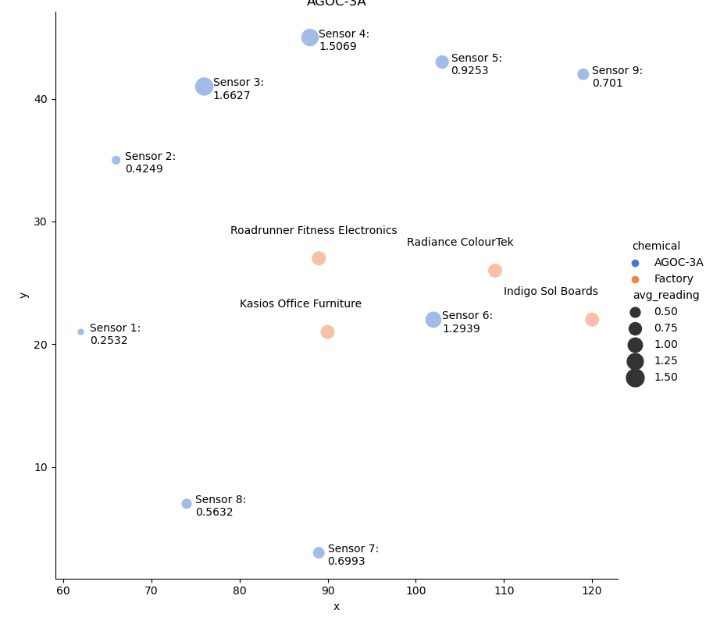
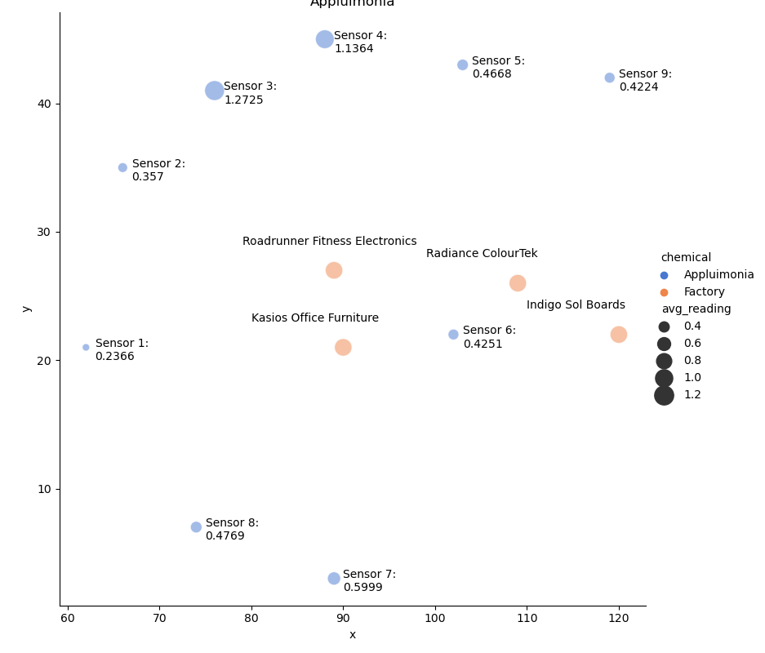
Average Readings per Chemical per Sensor (1/2)
AGOC-3A
Appluimonia

Slide 15
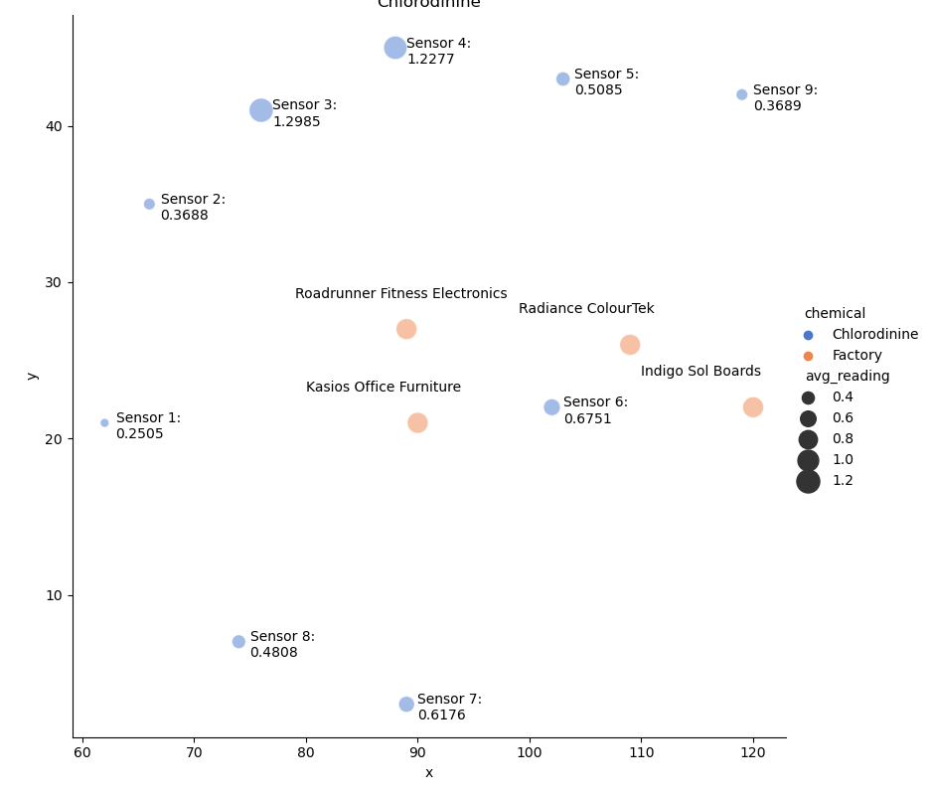
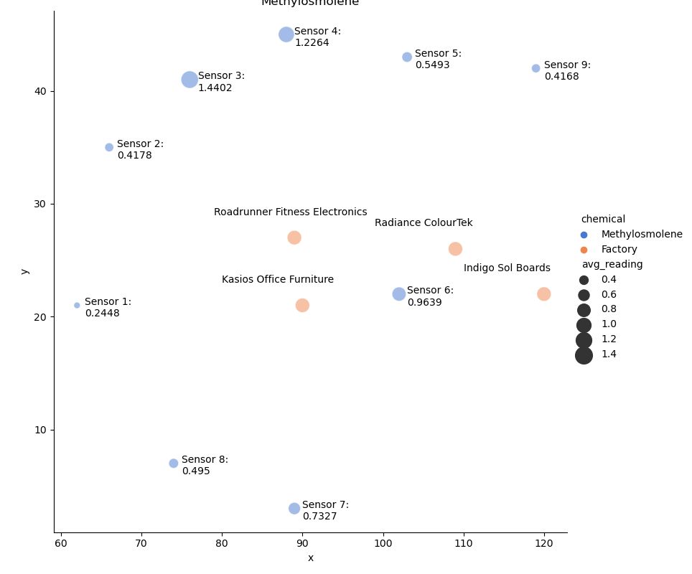
Average Readings per Chemical per Sensor (2/2)
Chlorodinine
Methylosmolene

Slide 16
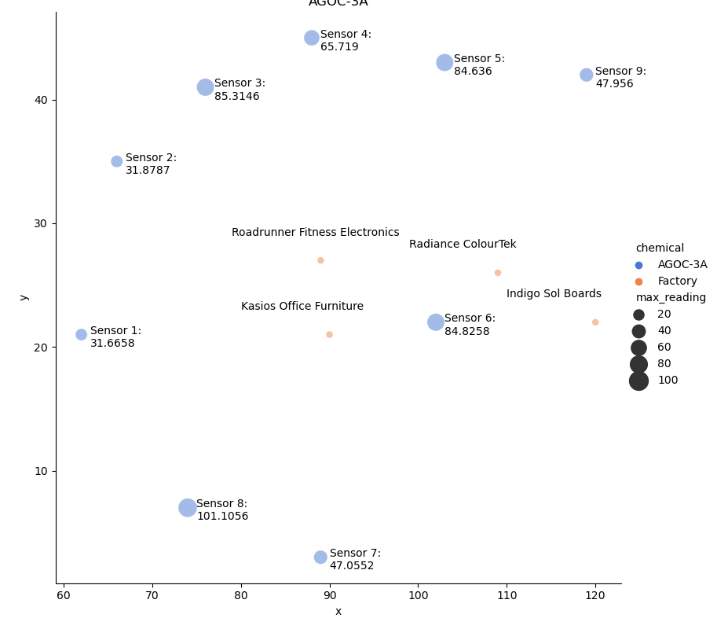
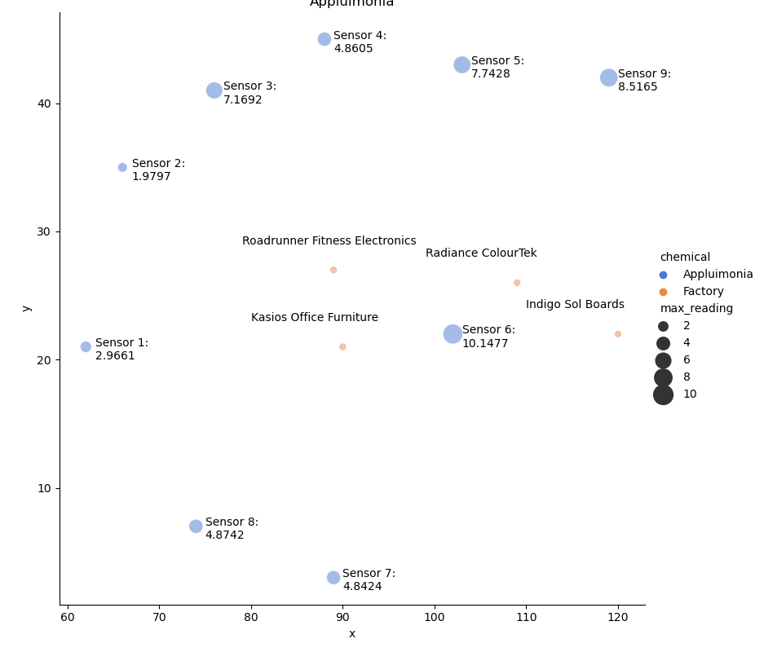
Max Readings per Chemical per Sensor (1/2)
AGOC-3A
Appluimonia

Slide 17
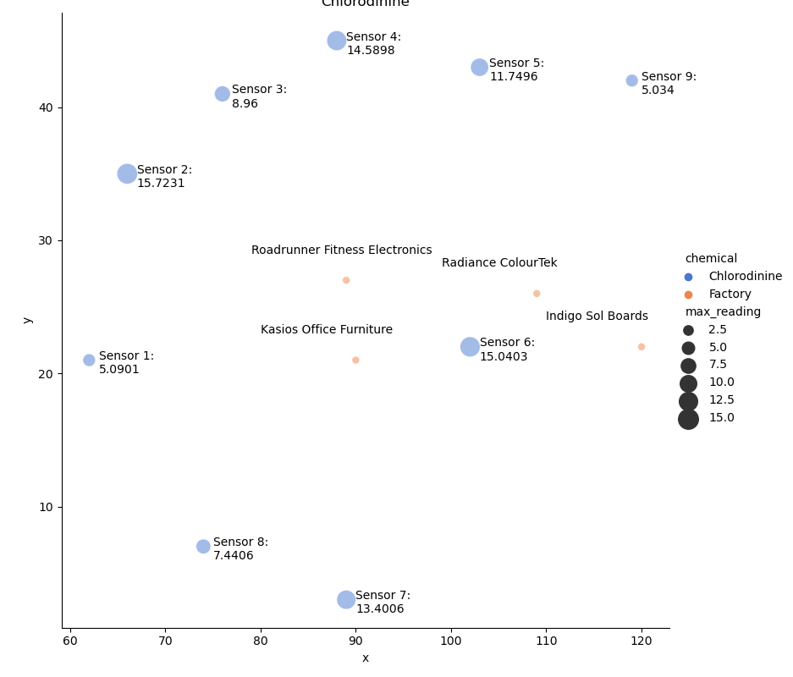
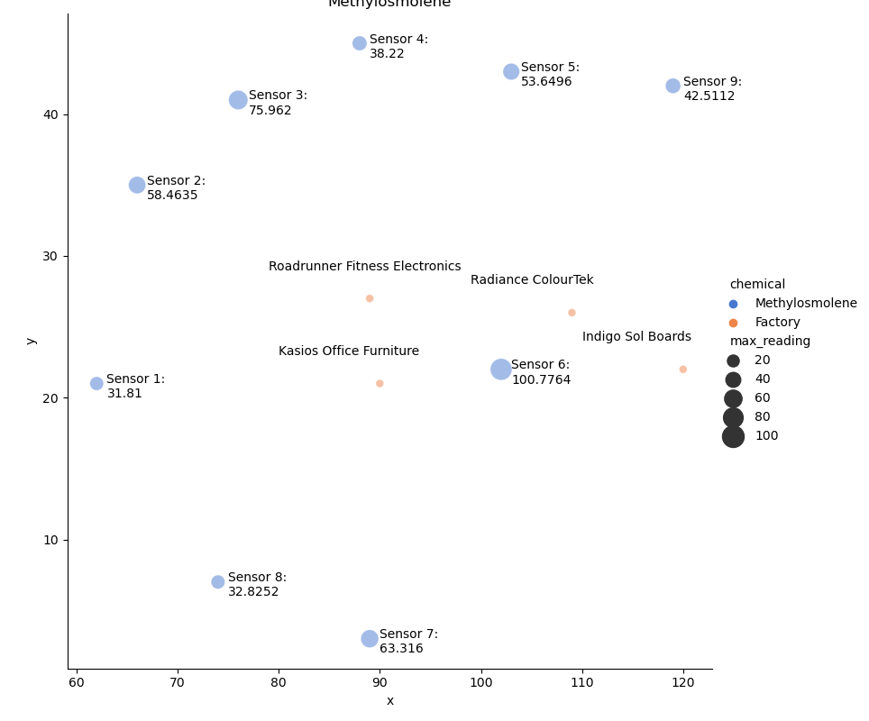
Max Readings per Chemical per Sensor (2/2)
Chlorodinine
Methylosmolene

Slide 18
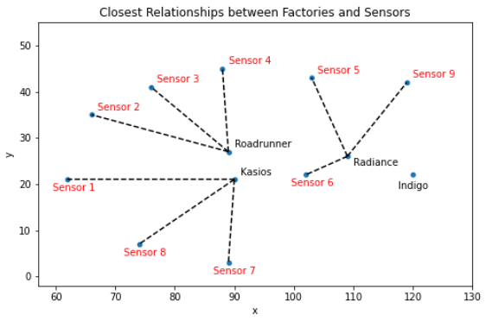
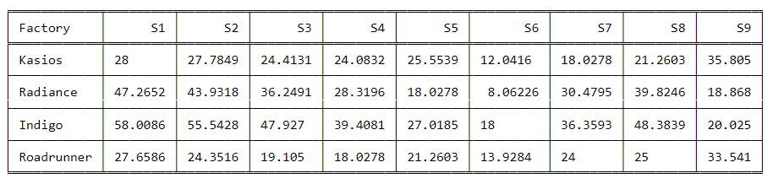
Which factories are responsible for which chemical releases?
Distance Analysis:
Kasios Office Furniture is closest to Sensors 1, 7, 8
Radiance ColourTek is closest to Sensors 5, 6, 9
Indigo Sol Boards is the furthers away from all sensors except sensor 9, however, it is not the closest factory.
Roadrunner Fitness Electronics is closest to Sensors 2, 3, 4

Slide 19
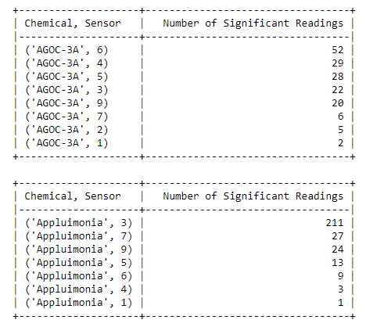
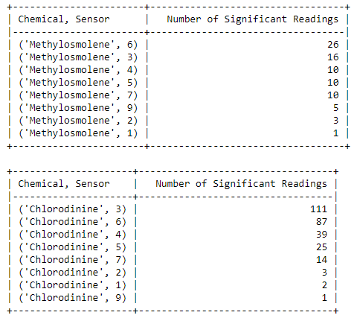

Which factories are responsible for which chemical releases?
To look at specific chemical releases, cutoffs were recalculated on a per chemical basis as opposed to the per sensor basis used to assess sensor performance.

Slide 20
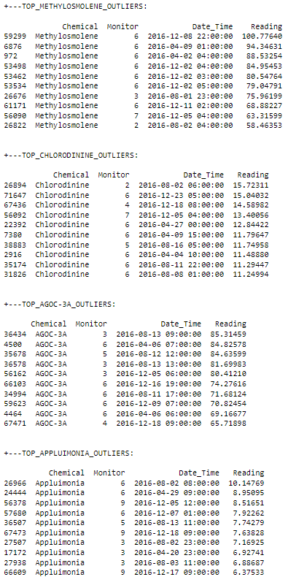
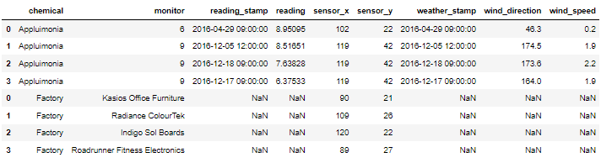
Which factories are responsible for which chemical releases?
Spikes were then grouped to see which sensors picked up the significant readings, shown in the figure to the right
This data was joined to weather data on the date/timestamp and to location data on the sensor. The businesses in the area also had their locations concatenated to the data frame.
This provides a basis to look at how chemicals may have moved across the area.

Slide 21
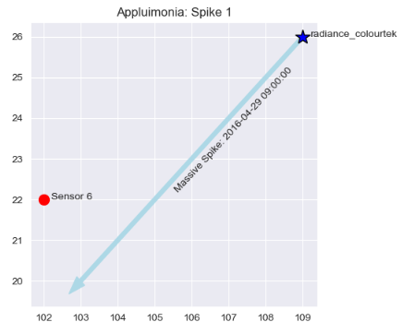
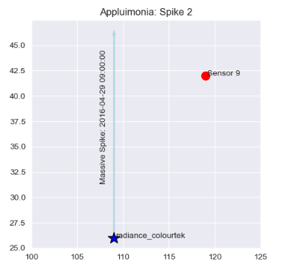
Which factories are responsible for which chemical releases?
Numerical analysis indicated that Radiance ColourTek was the likely perpetrator for large levels of Appluimonia. Applying the weather data confirmed this theory.

Slide 22
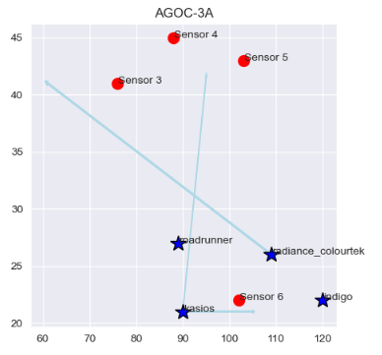
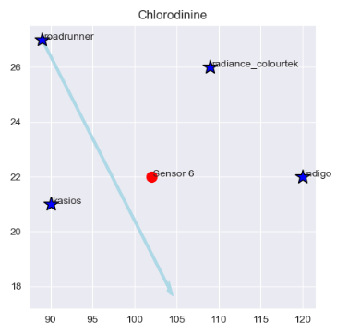
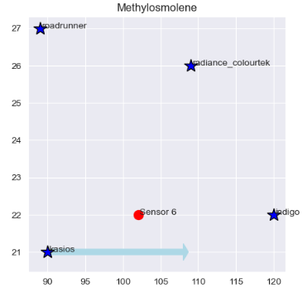
Which factories are responsible for which chemical releases?
NOTE: Each vector represents a spike recorded with wind direction applied; NOT concurrent wind patterns!

Slide 23
Conclusions
Radiance ColourTek seems to produce the most significant levels of Appluimonia. While not harmful at lower levels, the readings were at high enough levels that they were picked up across the testing area. A decrease in Appluimonia biproduct should be considered and enforced.
ACOG-3A, while also not harmful, was picked up across the area by all sensors. All businesses contribute to these levels, with Indigo being the least likely to output this chemical. However, no change is needed as this chemical carries no negative impact.
The cleaning agent Chlorodinine, which has dangerous consequences when inhaled or ingested, is predominantly from Roadrunner. An alternative disinfectant should be implemented at this business to reduce negative externalities.
Kasios seems to be the primary contributor to Methylosmolene production. The most dangerous of the chemicals with significant negative effects on vertebrates, these levels should be controlled, and their waste disposal protocols should be audited to ensure that the chemical is properly neutralized prior to disposal.

